Slide 1
Works
1
AttMIL (attention-based multiple instance learning)
BRAF mutation prediction
HER2 negative/positive prediction (functional protein)
MSI prediction
2
TransMIL (transformer-based correlated multiple instance learning)
BRAF mutation prediction
HER2 negative/positive prediction (functional protein)
MSI prediction

Slide 2
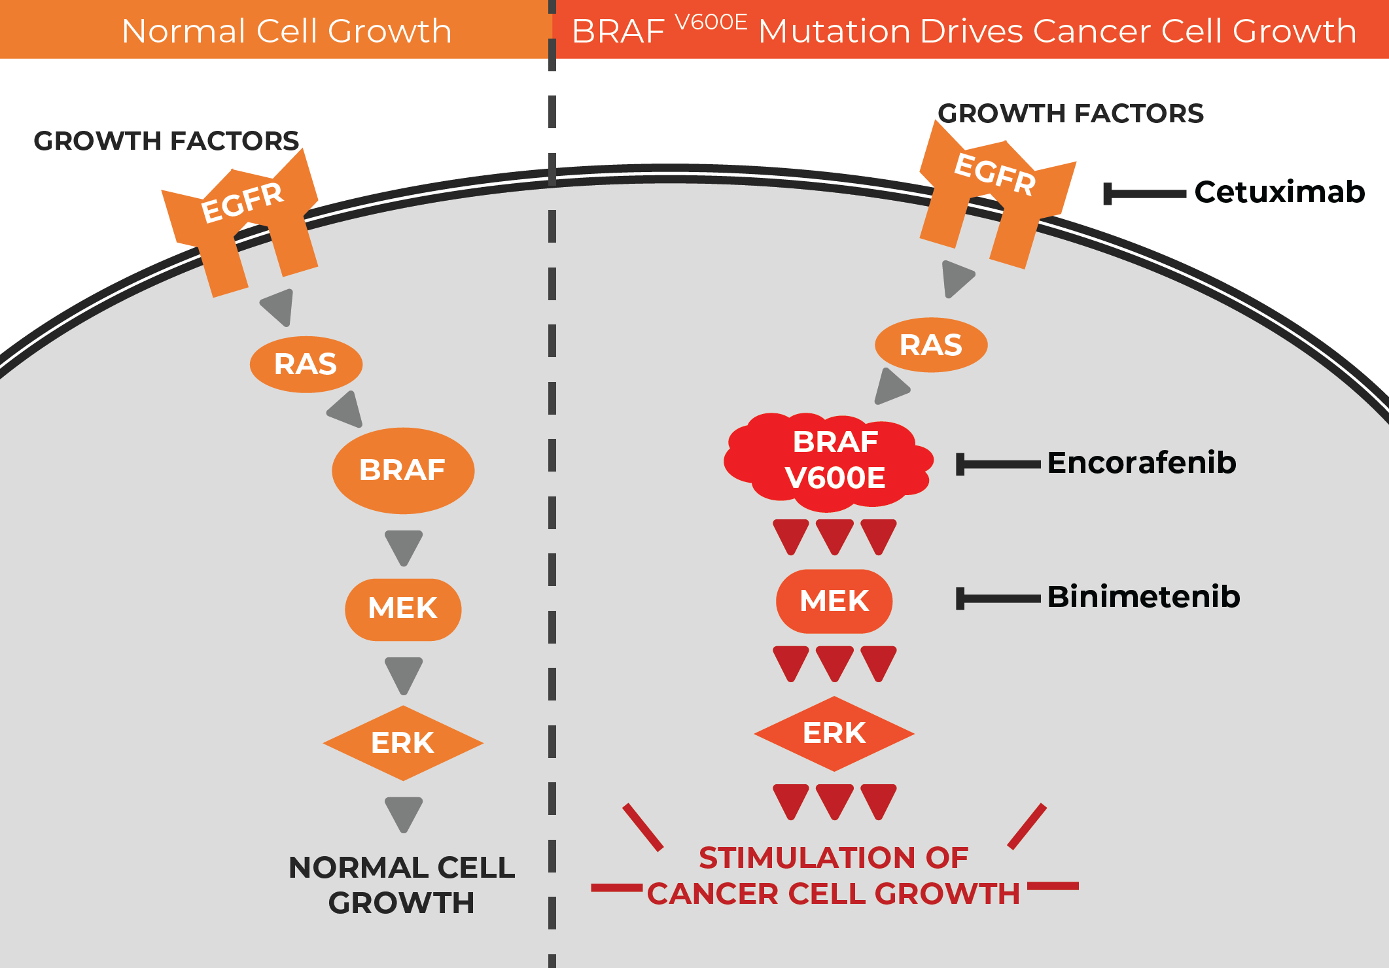
Correlation between CRC and BRAF
https://www.hopkinsmedicine.org/health/conditions-and-diseases/braf-mutation-and-cancer
https://www.cancer.gov/news-events/cancer-currents-blog/2019/colorectal-cancer-braf-triplet-targeted-therapy
BRAF is a gene that encodes a protein also called BRAF. This protein plays a role in cell growth by sending signals inside the cell promoting, among other functions, cell division.
BRAF mutation continue to have a very poor prognosis.
Therefore, when BRAF mutation occurs, the monoclonal antibody that inhibits the growth of epidermal cells is rendered ineffective.

Slide 3
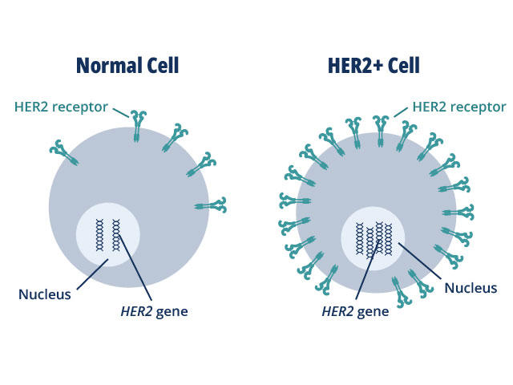
Correlation between CRC and HER2
HER2 (human epidermal growth factor receptor 2) is the functional protein that control how the cells grow and divide.
HER2 positive and negative are defined from the HER2 protein expression. When it is higher than normal level (0), it is called HER2-positive, otherwise, it is called HER2-negative.
Detect HER2-positive/negative is crucial for deciding target therapy medicine.
https://www.cancer.gov/news-events/cancer-currents-blog/2023/fda-tucatinib-her2-colorectal-cancer

Slide 4
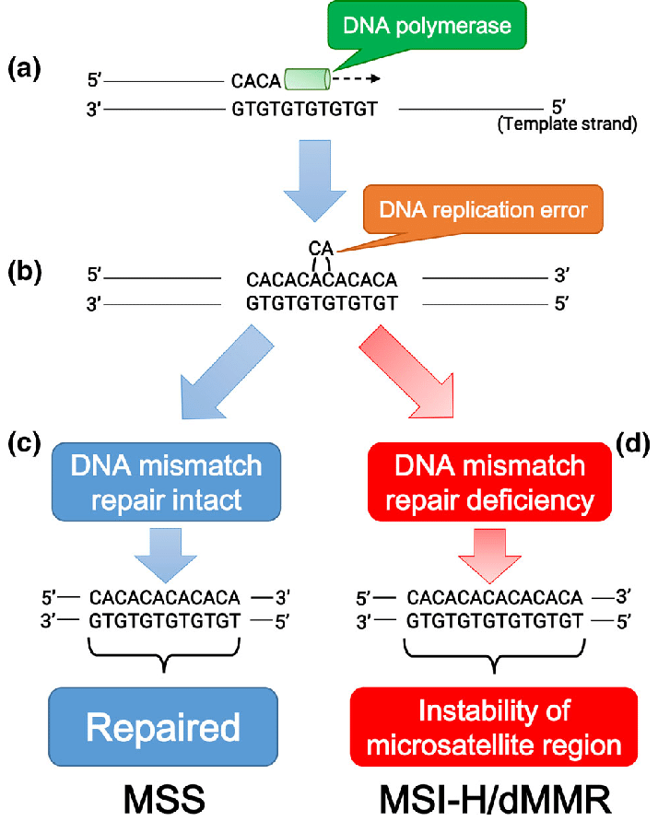
Correlation between CRC and MSI
Microsatellites are short, repeated sequences of DNA, also called simple sequence repeat.
Microsatellites instability (MSI) is a hypermutator phenotype that occurs in tumors with DNA mismatch repair deficiency (dMMR).
Medicine reference for pembrolizumab immunotherapy and help to decide the chemotherapeutics.
https://www.researchgate.net/figure/Schematic-diagram-of-microsatellite-stability-MSS-and-microsatellite-instability-high_fig1_335680888

Slide 5
Multi-level molecular profile label
Gene | KRAS
Wildtype | 243
Mutation | 181
Total | 424
Protein | HER2
negative | 189
positive | 146
Total | 335
Gene | BRAF
Wildtype | 364
Mutation | 60
Total | 424
DNA-seq | MS
MSS | 304
MSI | 51
Total | 355

Slide 6
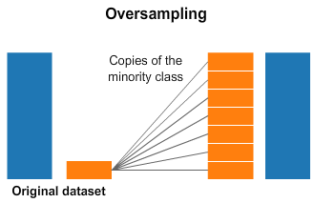
Training technique for imbalanced data - Upsampling
Upsampling or Oversampling refers to the technique to create artificial or duplicate data points or of the minority class sample to balance the class label.
https://towardsdatascience.com/5-techniques-to-work-with-imbalanced-data-in-machine-learning-80836d45d30c

Slide 7
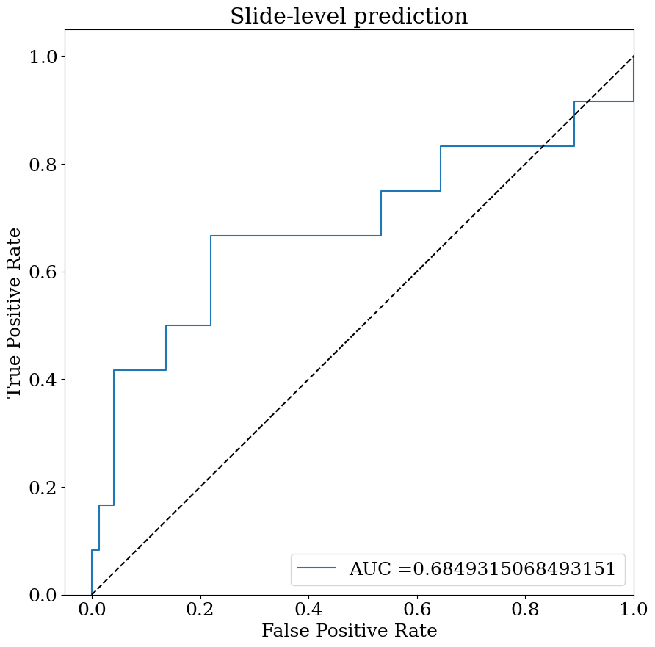
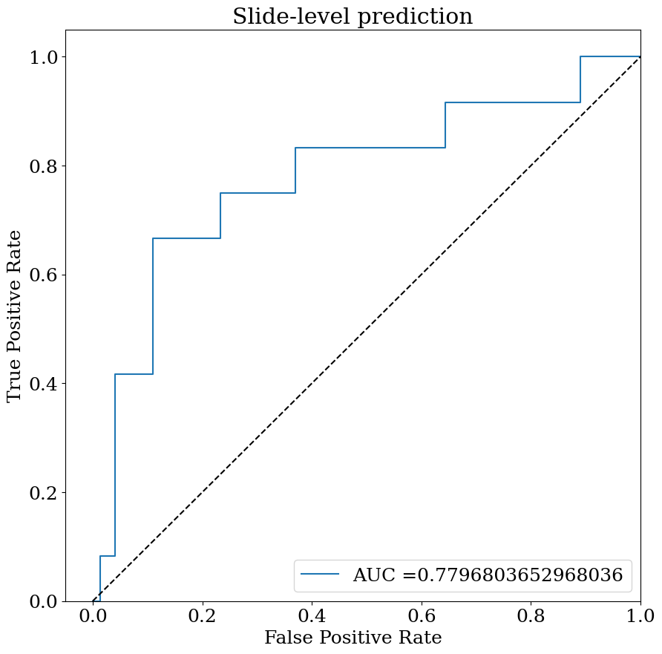
BRAF mutation prediction
attMIL: auc 0.69
transMIL: auc 0.78

Slide 8
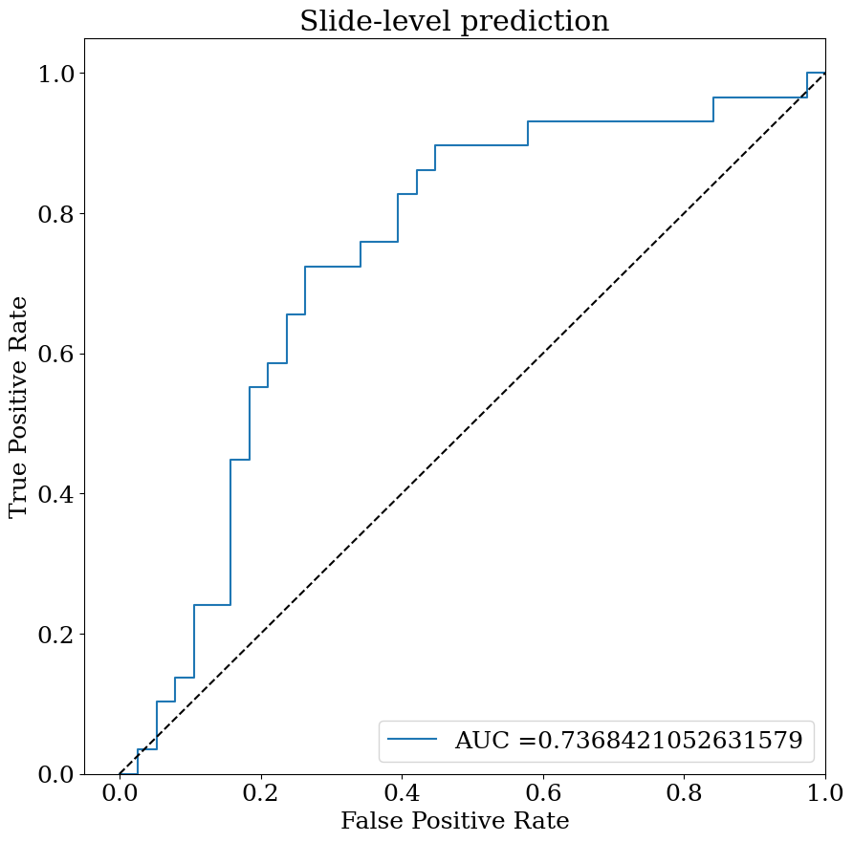
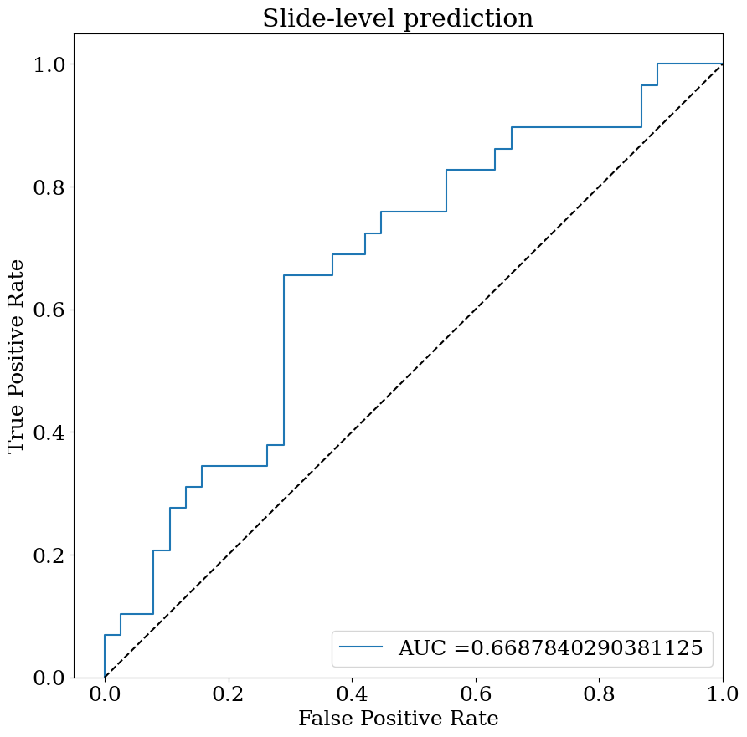
HER2 negative/positive prediction
attMIL: auc 0.74
transMIL: auc 0.67

Slide 9
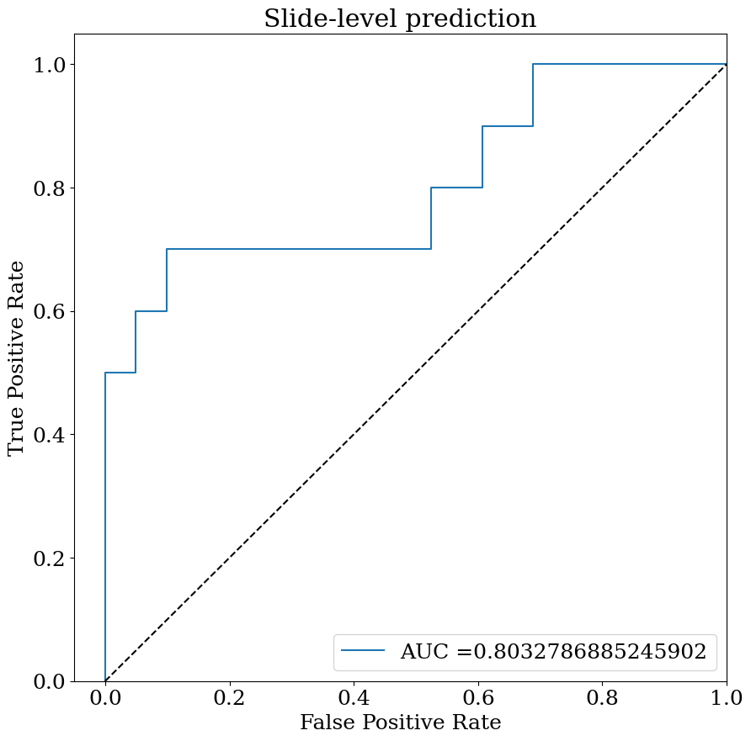
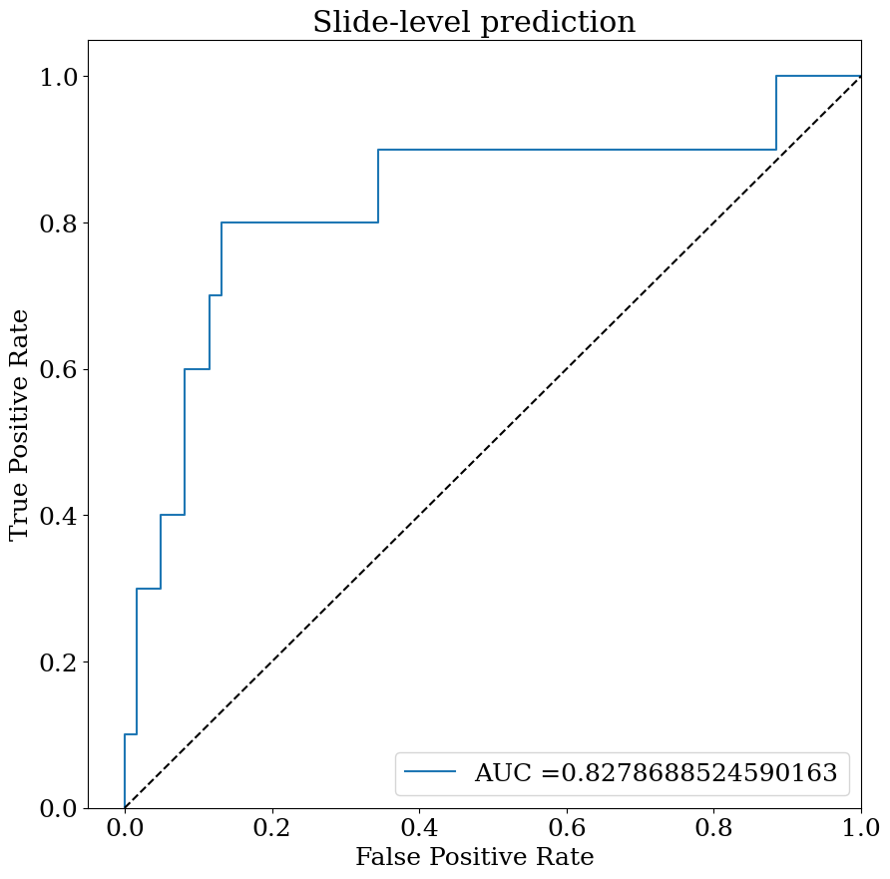
MSI prediction
attMIL: auc 0.80
transMIL: auc 0.83

Slide 10
Future work
1
Multiple instance learning with graph neural networks
2
Graphormer
3
Ensemble with attMIL, transMIL and GnnMIL

